Slide 1
EMOTION BASED MUSIC PLAYER🎶
SUBMMITTED BY:
Shubham Bharti
Ankush
6th Sem

Slide 2
Content
Objective
Flowcharts
Libraries Used
Merits of the system proposed
Application
Output Screen
Conclusion

Slide 3
Introduction
Project Emotion Based Music Player is a novel approach which helps user to play the songs according to their emotion / mood.

Slide 4
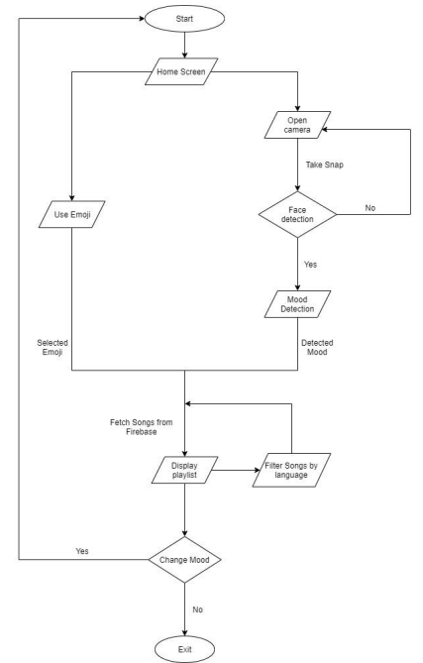
Flowchart

Slide 5
Libraries Used
OpenCV
OpenCV-Python is a library of Python bindings designed to solve computer vision problems.
Keras
Keras is an open-source software library that provides a Python interface for artificial neural networks.
NumPy
NumPy is a Python library used for working with arrays. It also has functions for working in domain of linear algebra, Fourier transform, and matrices.

Slide 6
Merits of the system proposed
The system is easy to use and is fully authorized.
It can be used to listen music in every type of mood.
It is not an electronic based system so one can easily make use of laptops to use this system.
It is free of cost.
It also saves the time to find different types of music.
It maximizes accuracy and reduces storage space usage.
More feature such as
Find every language of songs
Listen your favourite singer
much more...

Slide 7
Application
Plays songs according to user mood and emotions.
Act as plugins for website.
Recommended for YouTube.

Slide 8
Output Screen

Slide 9
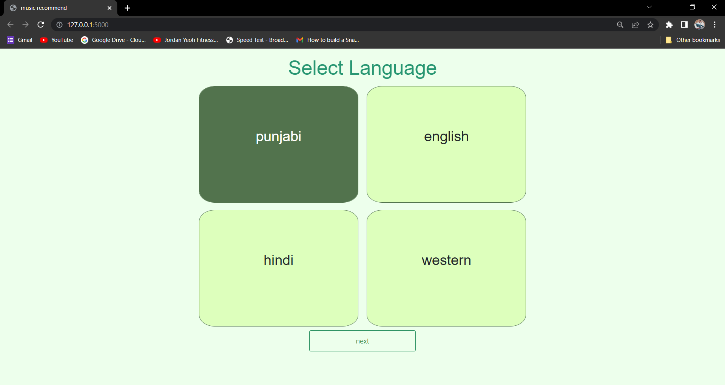
Language Selection

Slide 10
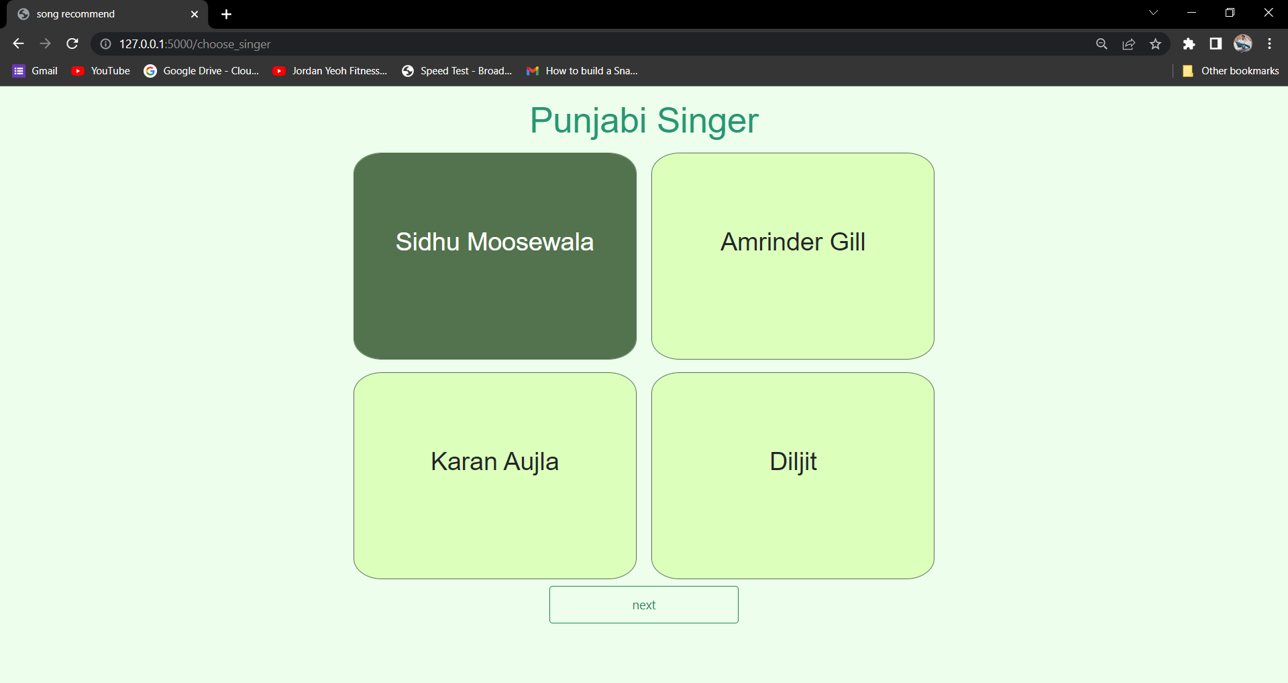
Favourite Singer Selection

Slide 11
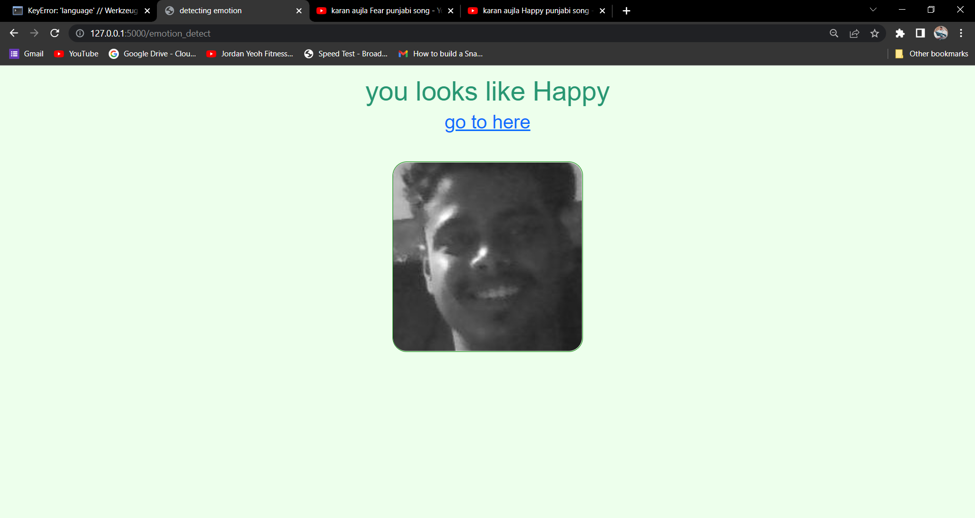
Face Detection

Slide 12

YouTube Screen

Slide 13
Conclusion
This Project has been developed to give us a great advancement in the field of human behaviour. In this project we have used more than 9 moods which can be ordinarily found in humans. Emotion Based Music Player fulfil to sort out music based on moods. Our main aim is to consume user’s time and to satisfy them. We have designed this platform in such a manner that it can run in Web browser.

